Slide 1



Case study: Using Bots, Power Apps, AI and Search to Lift Employee Engagement and findability
New Intranet: #CU.LIVE

Slide 2

1 The BOT Journey
1 Company Overview
Agenda
What we’ll discuss today
2 The solutions
1 Company Overview
3 The users
1 Company Overview
4 The Future
1 Company Overview

Slide 3
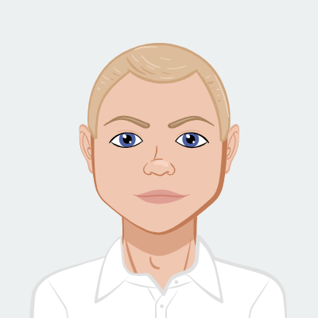

Thomas K.J. Julø
Former Officer(left in 98), sales manager, Office trainer & Business consultant
Worked with and for MAN Energy Solutions since 2011
Active in different communities, including sports and IT
Certified trainer, MTB, Run, Aerobics and Army teacher.
Digital Workplace Adoption Consultant
Certified Nerd

Slide 4

Company Overview
Who are we?
New Intranet: #CU.LIVE

Slide 5









We are a member of the Volkswagen Group
Automotive Division
Financial Services Division
Passenger Cars Business Area
Commercial Vehicles Business Area
Power Engineering Business Area
VW
VWN
MAN
Energy Solutions
Dealer and customer financing
Leasing
Direct bank
Insurance
Fleet management
Mobility offerings
MAN
Solutions
MAN
Solutions
MAN
Solutions
Dealer and customer
Leasing
Direct bank
Insurance
Fleet management
Mobility
Audi
Scania
MAN
Solutions
MAN
Solutions
Skoda
MAN
Truck & Bus
MAN
Solutions
MAN
Solutions
Seat
MAN
Solutions
Bentley
MAN
Solutions
Porsche
MAN
Solutions
Others
MAN
Solutions

Slide 6
Our Sites around the Globe
F
R
EDE
R
I
K
S
H
A
V
N
HA
MB
U
R
G
G
O
THENBURG
SE
T
UB
A
L
>140
S
E
A
T
T
L
E
L
OS
A
N
G
EL
E
S
H
O
NG
K
O
NG
V
AD
O
D
AR
A
locations
P
A
R
A
NQ
UE
C
IT
Y
14,127
P
E
RTH
M
E
L
B
OU
R
NE
A
U
C
KL
AN
D
SYDNEY
Employees worldwide

Slide 7
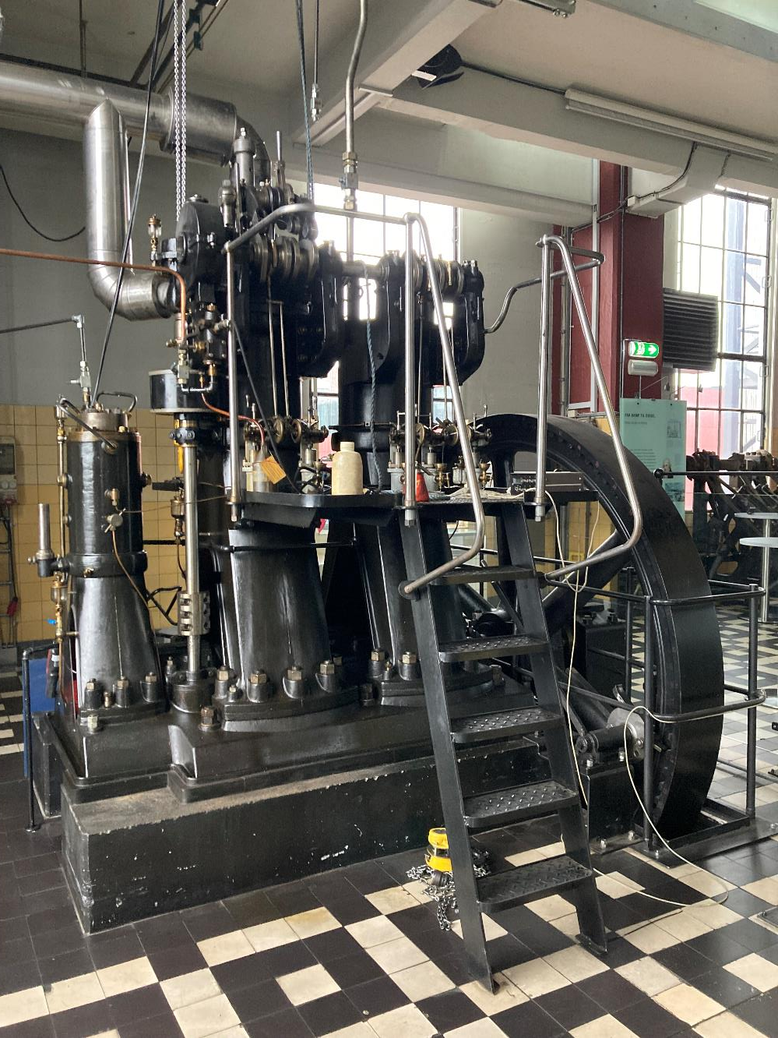
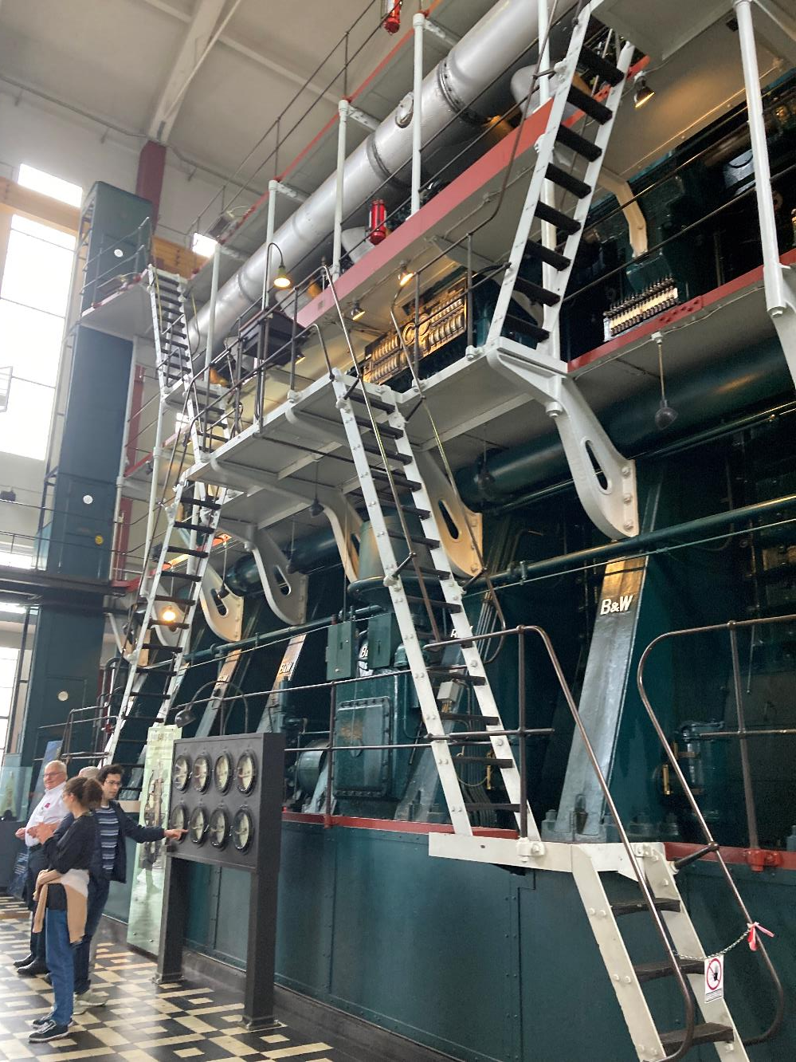

Slide 8
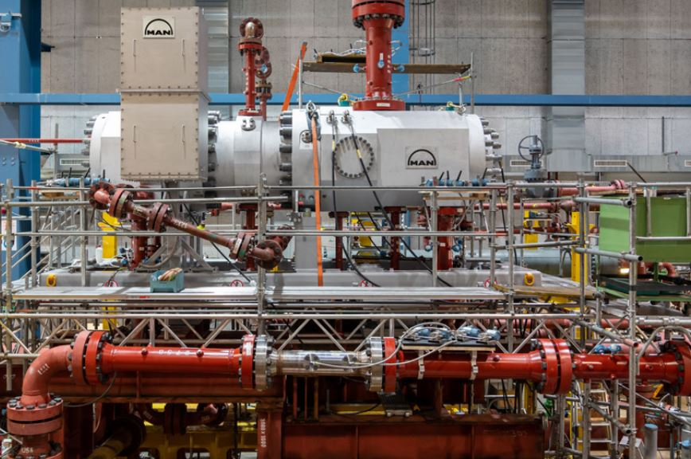

Slide 9


Slide 10


Why a BOT?
The BOT journey
New Intranet: #CU.LIVE

Slide 11



Why did we build MOBO
To replace different search and QnA solutions
To meet the needs of our users
To gain flexibility and better guidance for the users
To share knowledge in one central place that is always up-to-date
AI was on its way, so it was easy and fast
2021
Detached services
Anti AI
2023
Connected services
OOTB

Slide 12
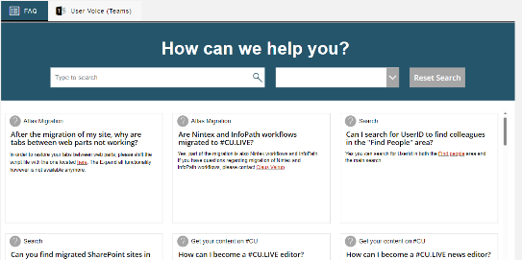
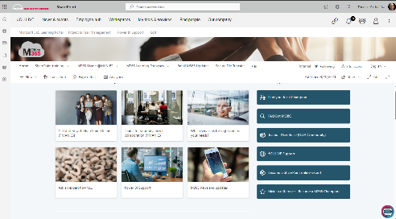
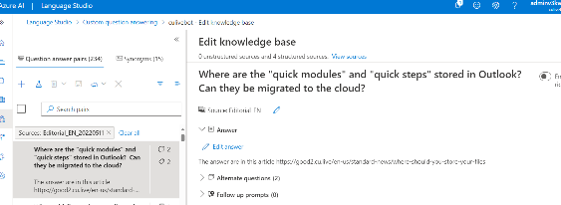
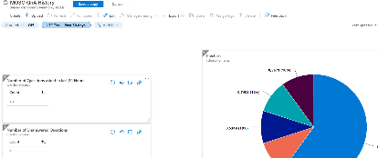
MOBO Foundation
Scope
M365 services
UK/DE
Direct guides and links
“AI”
SharePoint Online access
Learning Portal
Optional on the #CU.LIVE
Technique and services
Azure cognitive services
Azure AI Language Studio

Slide 13
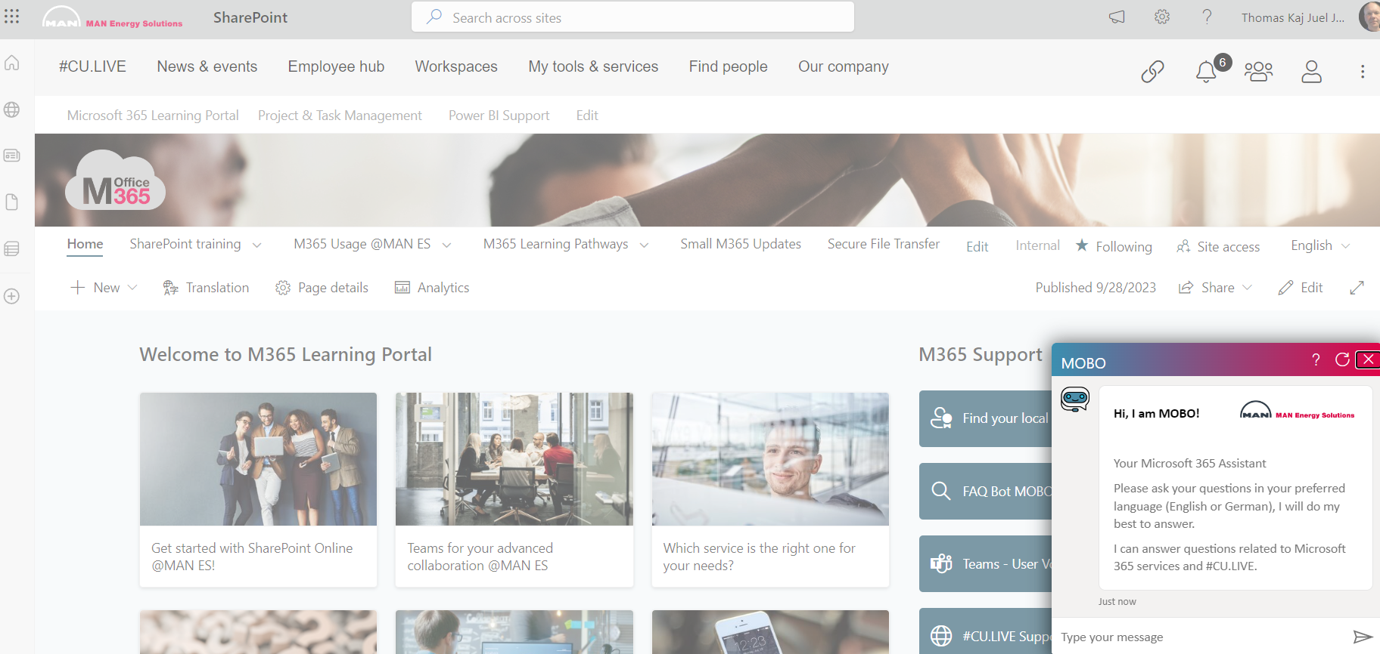

Slide 14

MOBO did not work as intended
Time consuming maintenance
Developer needed for web part updates
Low quality answers
Teaching the MOBO KB
User expectations
Low usage
Security

Slide 15

The search future
Status & overview
New Intranet: #CU.LIVE

Slide 16
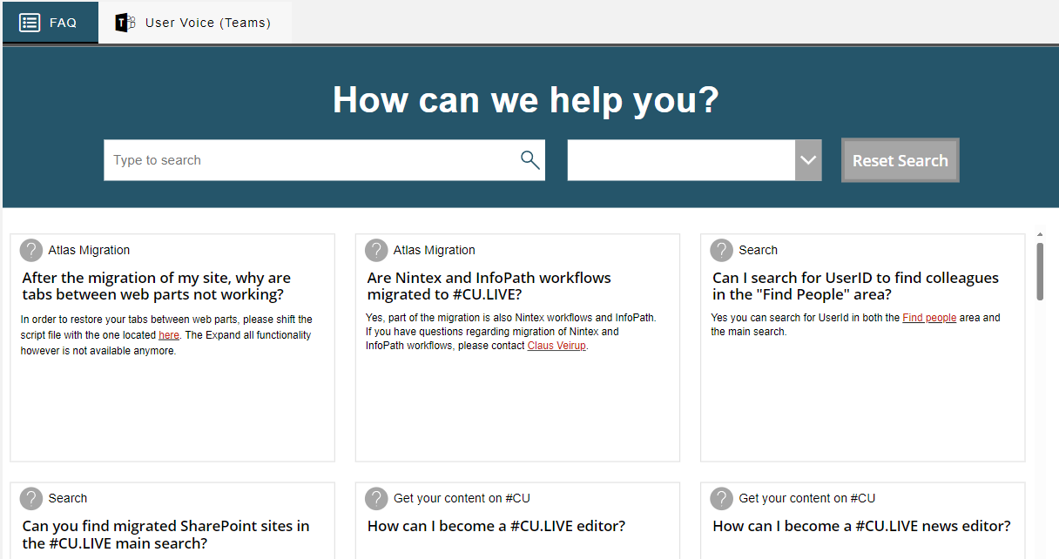
The new solutions
As of October 2023…
#CU.LIVE search (Omnia)
Microsoft Search
Acronyms
Bookmarks
Locations
Q&A
Topics
Bing/Work
MOBO
PowerApps FAQ
(AI)

Slide 17
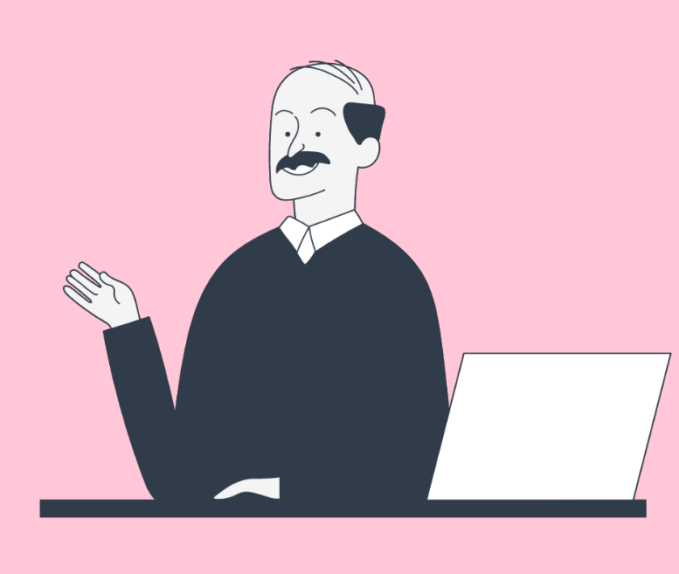
The users
Needs training
New Intranet: #CU.LIVE

Slide 18
TEACH and educate
Virtual Training
300 Champions, business representatives worldwide from all business units and locations.
Provide M365 and #CU.LIVE support to colleagues
Approximately 20 core champions
Onsite Training in Copenhagen

Slide 19
However… These initiatives are not without user statements
Intranet search sucks
SharePoint Search sucks
Teams Search sucks(true)

Slide 20
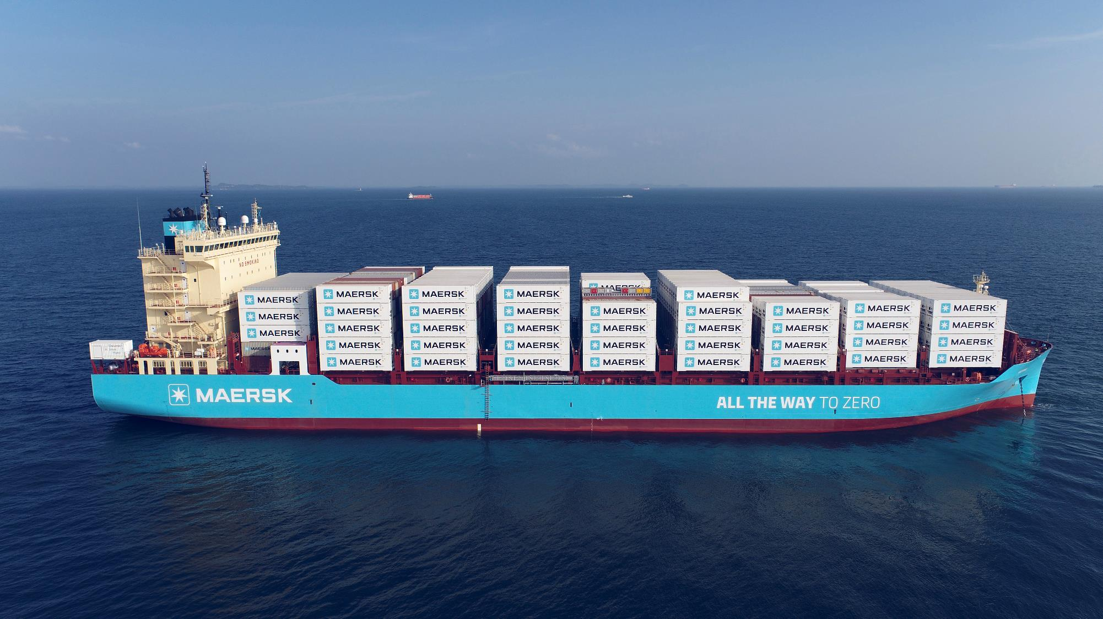


Slide 21
Demo time
#CU.LIVE
Search
PowerApp QnA
MOBO
(Setup)

Slide 22
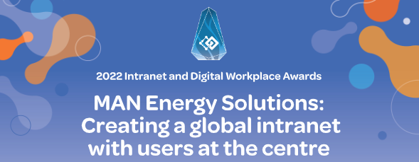
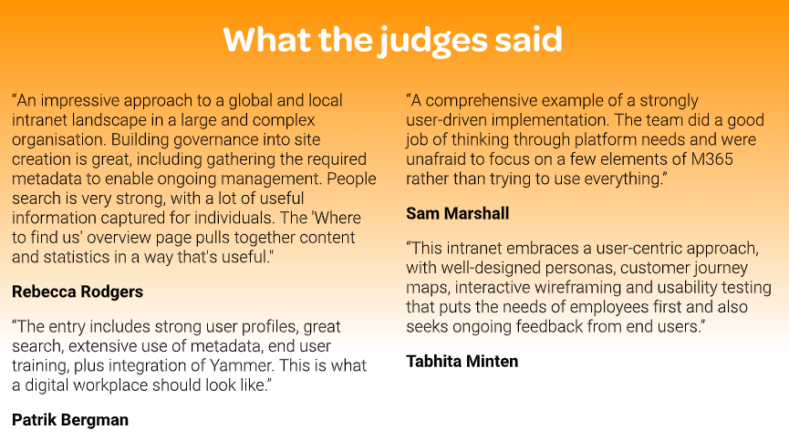
StepTwo
Gold award winner 2022
Why #CU.LIVE won – by StepTwo
Strong implementation methodology, highly committed to UX research and engagement from champions.
Local and global HR sections to strengthen relevance.
Valuable Workplace area with embedded guidance for selecting the right collaboration solutions.
Comprehensive search using metadata, e.g., providing extensive filtering options for finding people.
Strong approaches to supporting users and content publishers through learning resources and support communities.
Content owner dashboard is well executed and helps engage and sustain devolved publishers.
Applaud the commitment to content governance.
Achieving significant levels of adoption.

